Slide 1
Welcome to School
School Accounts Every Parent Needs

Slide 2
Accounts You Need For School
Power School: view report cards on-line, register for school
Microsoft Office: allows students and parents to use programs for on-line learning
School Cash On-line: allows parents to pay for school lunches, pay Early Learning Program Fees, Pay for additional expenses like field trips
School Messenger: Enter absences for students, check on student attendance
School Guide: This App for your phone connects you to Westminster and school district information. It gives you access to all 4 of the other apps on your phone too.

Slide 3
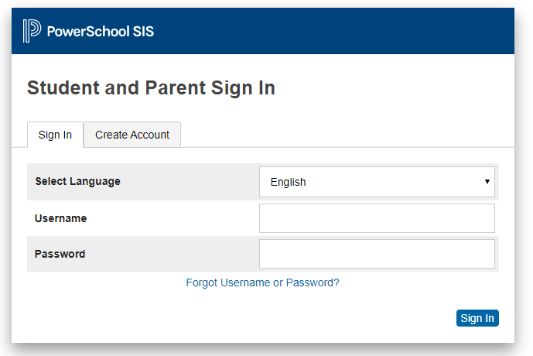
Power School: gives you access to report Cards, registration Go to http://west.lethsd.ab.ca Go to Quick Links ---- Create Account

Slide 4
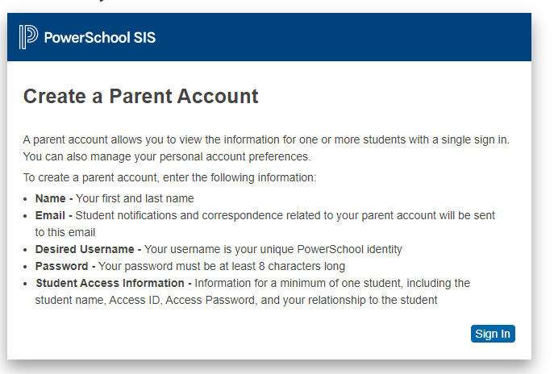
You can link more than one child and more than one school

Slide 5
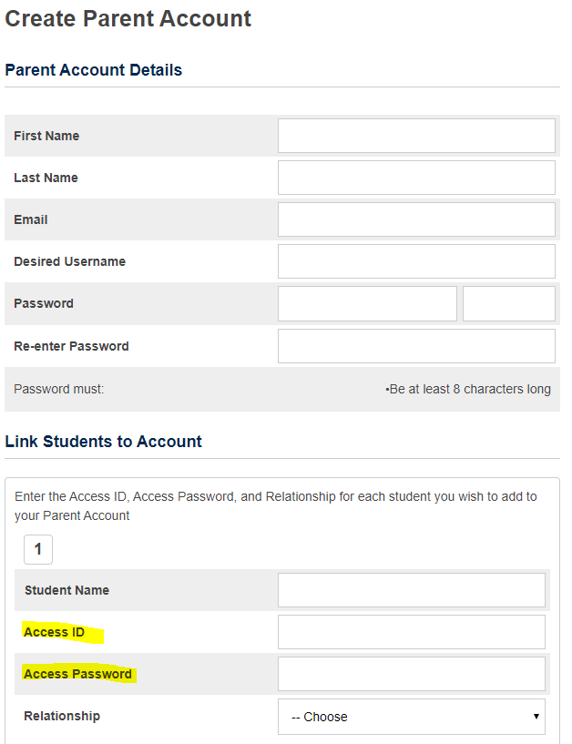
Power School
The first time you log in you will need a username and password from the school or schools that your child or children attend.
Teachers at Westminster will e-mail this directly to you.
If you have logged on before or forgot log-in information call the school. We can help you at 402-327-4169.

Slide 6
Microsoft Office 1 free download/family Helps kids do schoolwork on-line Gives your family access to programs like: Teams Word Excel Powerpoint
Microsoft office Suite 365
1) Go to http://west.lethsd.ab.ca
2) Click on Quick Links
3) Click on Office 365 Webmail
4) Log in with student information
(Username:John.doe(gradyear)@lethsd.ab.ca) (Password: your students Alberta School Number).
You may have changed password already. Call the school if you need help at 403-327-4169
5) Click the "Waffle" icon in the top left corner
6) Click "Office 365" In the top right corner of that menu
7) Click "Install Office 365" in the top right corner

Slide 7
Passwords
The School has a record of your child’s Alberta School Number (ASN). It is also on their report cards.
If you change the password from their ASN number – the school will not have that password saved.
The only way to “retrieve” the password is to reset it through the school back to the 9 digit ASN number.
Long story short – if you keep the password as the ASN number the school and parents will always be able to log into Microsoft 365.

Slide 8
Go to http://west.lethsd.ab.ca Go to Quick Links

Slide 9
You can register for this account with your credit card or banking information. You create your own username and password.

Slide 10
This is an app for your phone. Easiest way to enter attendance and get messages from school. IF you don’t have the app you can call number: 1-866-879-1041

Slide 11
This App for your phone allows you to connect to all information from the school and district and to your PowerSchool, School Cash On-line, Microsoft 365, and School Messenger accounts. Everything in one place including current school and district messaging. Create your own username and password.

