Slide 1
Here are some learning activities developed by the school division for students who are learning from home for short periods of time during January 2022.
You will need access to some books (Raz kids on-line is available to you from your child’s teacher). All other supplies students are to access from home.
If you are in Grade 1,2 or 3 you can choose from any of the following activities on slides 1, 2, 3, 4, 5, 6
If you are in Grade 4 or 5 you can choose from any of the following activities on slides 7, 8, 9, 10, 11.

Slide 2
Literacy Learning for Grade 1, 2, and 3
Week 1:
On this adventure, you will use a self-chosen fiction book. You can use the same book for more than one day. Each day you will choose one box to complete.
Advertisement: Create a poster or video that would convince another student to read your book. What makes it a great book? Who would like to read it? Try and sell your book. | Character Traits: A character trait is what a character is like on the inside, for example, kind, evil, distracted. Think about the main character in your book. Choose 3 words to describe what that character is like. What are their character traits? Tell why you chose those words. | Setting: Draw a picture of the setting of your story. The setting is where and when the story takes place. If the story happens in more than one place, decide which one seems most important. | Interview: You are a reporter and you are going to interview a character from your story. Write 6 questions for your character using the starters who, what, where, when, why, and how. Write how you think your character would answer your questions. | Retell What Happened: Tell somebody else what happened in your story. Be sure to include who the characters are, where and when the story happened, what happened in the beginning, middle, and end. Use words like first, next, then, finally.

Slide 3
Literacy Learning for Grade 1, 2, and 3
Week 2:
How To Writing
It is important to know how to write directions. Over this week you will practice how to writing. Think of something that you know how to do well. You will be teaching someone how to do that thing. It could be how to brush your teeth, shoot a hockey puck, ride a bike. What are you an expert at? Think about the steps you need to take to complete that task. Draw pictures and write the instructions. Give them to someone else to see if they can follow them. Sometimes it helps if you act it out while you write. Check out the video below to see what happens if your directions aren’t clear.
https://www.youtube.com/watch?v=Ct-lOOUqmyY

Slide 4
Math Learning for Grade 1, 2, and 3
 | Activity #1 | Activity #2 | Activity #3 | Activity #4 | Activity #5
Week 1 | Assemble an online or physical puzzle to practice spatial reasoning (piece count varies according to age level). | Play a card or board game to practice number sense. Some good options include War or Go Fish! | Practice sequencing by connecting the dots online or on printable sheets. | Organize or sort all your toys according to a single attribute. OR Help a parent organize a room, drawer, or cupboard. | Design and draw a building using a rectangle, triangle, square, and circle. Or Go on a walk and find a rectangle, triangle, square, and circle outside.
Week 2 | Practice counting: count the number of windows, light switches, etc. in your house. For older students, practice operations (i.e. add number of doors AND windows). | Spot the differences! | Write or draw all the steps needed to make a PB&J sandwich. Cut them out and place them in order (sequencing). Video | Play a different card or board game to practice number sense. Some good options include: War or Go Fish! | Assemble a different online or physical puzzle to practice spatial reasoning (piece count varies according to age level).

Slide 5
Social Grade 1, 2, and 3
Grades 1-3, – Growing and Changing Communities
In what ways can individuals and groups contribute to positive change in the world? Take a walk through your community and look carefully for important features of the landscape, buildings, parks, statues, or monuments.
How do these things contribute to and improve your life? Draw a map of your local community and mark the locations of the features you observed. Do you notice anything missing?
What sorts of features could improve your quality of life or contribute to positive community change?
Design and sketch the feature you’d like to see in your local community and represent it with a symbol on your community map. Use recyclable household supplies to build a model of your invented feature, then write 3-5 sentences describing the model and why you think it would be important to build as your community continues to change and grow.

Slide 6
Science Grade 1, 2, and 3
Grades 1-3, Science – Towering Materials (Testing Materials and Designs)
Design a tower using household recycling and other available materials!
Start by imagining the materials and shapes that will help you construct a tower that doesn’t crush, bend, or topple over easily.
Draw 3 possible designs for your tower, labeling the materials you’ll use.
Pick the design you think will be the strongest. Which materials will work best, and why?
Build the tallest freestanding tower possible, without it tipping over or being held up by anything (or anyone) else.
When your tower is built, take a selfie with it to send to your classroom teacher, then ask a family member to help you measure the height of your tower.
You can use a measuring tape, or an invented unit of measurement—like arm-lengths.

Slide 7
Literacy Learning for Grade 4 and 5
Week 1:
On this adventure, you will use a self-chosen fiction book. Each day you will choose one box to complete.
Quotes: Copy down 3 meaningful quotes from the book. Why did you choose them? Why did they seem important? | Character Changes: How does the main character in your book start out and how do they change throughout the story? Find places in the book that show how the character changes. | Setting: Draw or describe a background from your book That shows the setting of one or more important scenes for the characters. | Timeline: Create a timeline with the most important events from the story. | Lessons Learned: Choose an image or words to show lessons the main character learns throughout the story. Write about what the lessons teach them. What did you learn?

Slide 8
Literacy Learning for Grade 4 and 5
Week 2: Inquiry Project
Ever wanted the chance to learn more about a topic of interest to you? Now is the chance. Think about something that you are curious about. Create at least 3 questions about that topic that you would like to find answers for. These questions shouldn’t be easily answered by doing a Google search. They should require looking in more than one place to find or form your own answers. Your end product can take many forms: a podcast, story, report, newspaper article, presentation, video, etc. It should showcase new learning for you. Make sure you include where you got your information from.

Slide 9
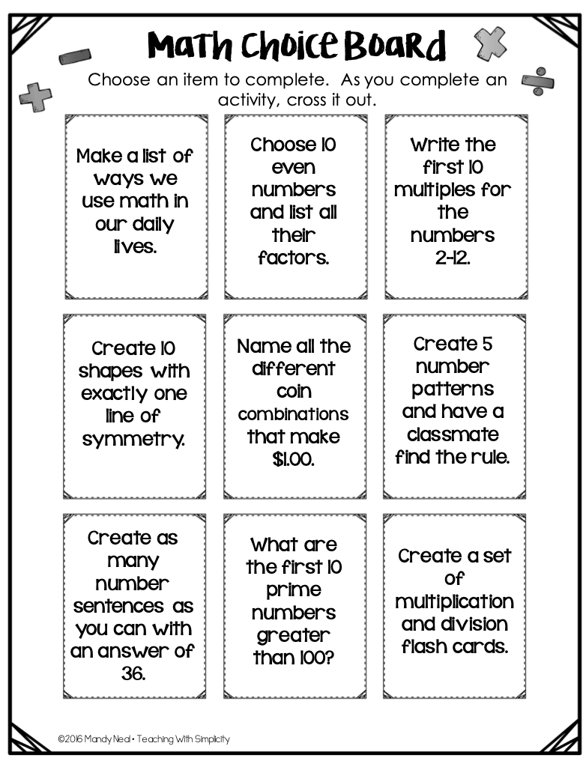
Math Learning for Grade 4 and 5
https://www.topmarks.co.uk/Search.aspx?Subject=16
https://www.mathplayground.com/
https://ab.mathgames.com/
https://www.factmonster.com/math/flashcards

Slide 10
Grade 4,5 Science – Investigating the Natural World
Natural Exploration | Critical Observation | Questioning and Experimentation | Evaluation and Persistence | Reflect, Adjust, Refine, and Interpret
Plants and animals make waste that is recycled in nature. Explore your yard or a public park looking for examples of natural waste (e.g., waste that does not come from human activity). Which types of animals and organisms benefit from natural waste and how? Is all waste that comes from human activity necessarily bad? Why or why not? How could waste from human activity be disposed of in a way that helps the natural world? Reflect on these questions in a journal entry using pictures and words. | On a neighbourhood walk, Look for examples of litter. Identify which types of waste are most common. Create a chart to organize waste by the types of materials it is made of. Take field notes of what you find, using pictures and words to represent and describe what you see. Do the materials break down easily in nature, or do they last in the environment for many years? How could this litter be disposed of differently? Design a poster reminding people about how to properly dispose of their waste and the benefits of reducing some types of waste overall. | Wetland ecosystems and their habitats are unique, diverse, and important to plants, animals, and humans. On a walk through our local wetlands, carefully observe, identify, and take field notes about the plants and animals that can be found there. Use pictures and words to represent and describe your observations. Do you notice ways that human actions could be impacting wetland ecosystems? How? How could individuals and groups act to preserve and improve the quality of wetland habitats through conservation? Create a plan that identifies human actions to protect wetland habitats. | Trees and forests are important habitat for animals and capture carbon and produce oxygen for humans. On an urban forest walk, notice the different types of trees. What does their bark look like? What do their branches look like? What do their leaves look like, what shapes are they, and do they grow in patterns on trees? What sorts of animals can be found on, under, or around them and how do they affect each other? Take field notes of your observations, sketch 4 different trees you find on your walk, and organize them based on their characteristics. Compare and contrast the similarities and differences between the 4 types of trees you identified on your walk. | Why is the natural world so important? Identify reasons why trees and forests are so important to animals and humans. Reflect on the ways that humans rely on trees and forests. What are examples of human actions that support forests? What are some examples of human actions that put forests at risk? How can we balance the use of trees to meet many human needs with the need for a life-supporting environment? Do you notice a conflict between human need and conservation? Write a 3-paragraph essay comparing and contrasting perspectives on the need for tree/forest use and the need for conservation. Develop an opinion about actions humans should take. Use evidence to support your position.

Slide 11
Social Studies for Grade 4 and 5
Grades 4-6, Social Studies,– Picturing Diversity as Canada’s Identity
It’s important to look at media critically and to consider issues from multiple perspectives. Examining a variety of historical photographs and newspaper articles using the Internet (Alberta Heritage Resources, Historica Canada, The Canadian Encyclopedia) consider who/what is and who/what is not represented, and how the subjects and objects are represented.
What can images tell you about the era when a photo was taken? How do you know?
Think about the style of dress, the buildings and objects in the background, and what people are doing in the pictures.
Take or collect a variety of pictures and create a photo collage that demonstrates a diversity of cultural influences in Alberta. Use the collage to tell the story of diversity in your community.
Write a poem that celebrates the strength in diversity to accompany the collage.

